Slide 1
HOME AUTOMATION
MINI PROJECT
EEE
ANALOG ELECTRONICS
HANDLED BY;
Dr.R.C IIAMBIRAI

Slide 2
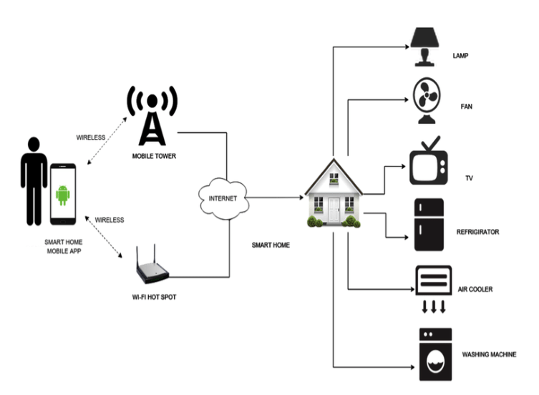
OUR CONCEPT OF IDEA

Slide 3
MATERIALS THAT WE USED;
*ESP8266
*Relays 5v (SPDT) (4 no)
*BC547 Transistors (4 no)
*PC817 Optocouplors (4 no)
*510-ohm 0.25-watt Resistor (4 no) (R1 - R4)
*1k 0.25-watt Resistors (5 no) (R5 - R9)
*LED 5-mm (5 no)
*1N4007 Diodes (5 no) (D1 - D5)
*Terminal Connectors
*5V DC supply
*9V DC SUPPLY

Slide 4
